Slide 1
Unix File APIs

Slide 2
Learning Objectives
After Learning of this chapter Student will Know About:
Creation of Files.
Reading of Files.
Writing of Files.
Closing of Files.
Remove Files
Query File Attributes
Change File Attributes
Truncate files

Slide 3
General file APIs
Some special APIs to create different types of Files:
Close Terminates connection to a
file
Open | Opens a file for data access
Read | Reads data from file
Write | Writes data into file
lseek | Allows random access of data in a file
Stat,fstat | Queries attributes of a file
Close | Terminate the connection of the file
Chmod | Changes access permission of a file
Chown | Changes UID and GID of a file
Utime | Changes last modification and access time of a file
Link | Creates hard link of a file
Unlink | Deletes hard link of a file
Umask | Sets default file creation mask

Slide 4
Open function(Open API )
The function establishes connection between process and a file.
Open existing file for data transfer function or it may be also used to create new file.
Return value is File descriptor value which contain inode information.

Slide 5
The prototype of the Open function
#include <sys/types.h>
#include <fcntl.h>
int open (const char *pathname, int access_mode , mode_t permission);

Slide 6
Successful – Returns integer Value that represents open file descriptor.
Unsuccessful – Returns -1
Pathname : pathname of a File
It can be absolute path name or a relative path name.
If the given pathname is symbolic link, the open function will decide the symbolic link reference to a non symbolic link file to which it refers.

Slide 7
Access_mode : An integer which specifies how file is to be accessed by calling process.
Access mode flag | Use
O_RDONLY | Opens file for read- only
O_WRONLY | Opens file for write -only
O_RDWR | Opens file for read & write

Slide 8
Other Access modes are termed as Access modifier flag
Access Modifier Flag | Use
O_APPEND | Append data to the end of file
O_CREAT | Create the file if it doesn’t exist
O_EXCL | Generate an error if O_CREAT is also specified and the file already exists
O_TRUNC | If file exists discard the file content and set the file size to zero bytes
O_NONBLOCK | Specify subsequent read or write on the file should be non-blocking
O_NOCTTY | Specify not to use terminal device file as the calling process control terminal

Slide 9
int fdesc=open(“/usr/xyz/textbook”, O_RDWR | O_APPEND, 0);
File is opened Read only – file is already exist, no other modifier flag can be used.
File is opened for write only or Read-write any modifier flag can be specified.
O_APPEND, O_TRUNC, O_CREAT and O_EXCL are applicable to regular files.
O_NONBLOCK is for FIFO and Device file only.
O_NOCTTY is for terminal device file only

Slide 10
O_APPEND
It specifies that data written to a named file will be appended at the end of the file.
If this is not specified, data can be written to anywhere in the file.

Slide 11
O_TRUNC
It specifies that if a named file already exists, the Open function should discard its content.
If this is not specified current data in the will not be altered by the open function.

Slide 12
O_CREAT
It specifies if a named file does not exist, the open function should create it.
Named file does exist, O_CREAT has no effect on the Open function.
File does not exist and O_CREAT is not specified OPEN will abort with a failure return status.
O_EXCL specified with O_CREAT open function will fail if the named file exists.
O_EXCL is used to ensure that the open call creates a new file.

Slide 13
O_NONBLOCK
It specifies that if the open and any subsequent read or write function call on a named file will block a calling process,
the kernel should abort the functions immediately and return to the process with a proper status value.

Slide 14
O_NOCTTY
If a process has no controlling terminal and it opens a terminal device file,
that terminal will not be controlling terminal of the process.

Slide 15
Permission argument
It is required only if the O_CREAT flag is set in the access_mode argument.
It specifies the access permission of the file for its owner group and all other people.
Data type is int in UNIX V.3 and value is usually specified octal integer literal value.

Slide 16
POSIX.1 defines the permission data type as mode_t.
Its vales is based on the manifested constant defined in the <sys/stat.h> header.
Manifested constants are aliases to the octal integer value used in UNIX V.
Example: 0764 permission specified as
S_IRWXU | S_IRGRP | S_IWGRP |S_IROTH

Slide 17
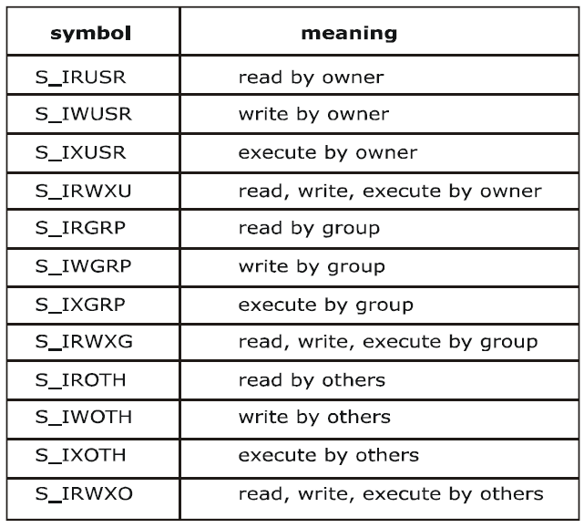

Slide 18
Umask
It specifies some access rights to be masked off
Prototype:
mode_t umask ( mode_t new_umask);
mode_t old_mask =
umask (S_IXGRP|S_IWOTH);
/*removes execute permission from others and write permission from group*/

Slide 19
Creat
It is used to create new regular files
#include <sys/types.h> #include <unistd.h> Int creat (const char* pathname,mode_t mode)

Slide 20
PATH_NAME: pathname of a file to be created.
MODE: same as OPEN API.
The creat function can be implemented using open function as:
#define creat(path_name, mode)
open (pathname, O_WRONLY | O_CREAT | O_TRUNC, mode);

Slide 21
Read
This function fetches a fixed size block of data from a file referenced by a given file descriptor
#include <sys/types.h> #include <unistd.h> ssize_t read (int fdesc ,void* buf, size_t size);

Slide 22
If successful, read returns the number of bytes actually read.
If unsuccessful, read returns –1.
The first argument is an integer, fdesc that refers to an opened file.
The second argument, buf is the address of a buffer holding any data read.
The third argument specifies how many bytes of data are to be read from the file.
The size_t data type is defined in the <sys/types.h> header and should be the same as unsigned int.

Slide 23
There are several cases in which the number of bytes actually read is less than the amount requested
When reading from a regular file, if the end of file is reached before the requested number of bytes has been read.
For example, if 30 bytes remain until the end of file and we try to read 100 bytes, read returns 30. The next time we call read, it will return 0 (end of file).
When reading from a terminal device. Normally, up to one line is read at a time.
When reading from a network. Buffering within the network may cause less than the requested amount to be returned.
When reading from a pipe or FIFO. If the pipe contains fewer bytes than requested, read will return only what is available.

Slide 24
Why the data type of buffer is a universal pointer (void *)
The return value of read is the number of bytes of data successfully read and stored in buf argument.
Normally equal to the size value.

Slide 25
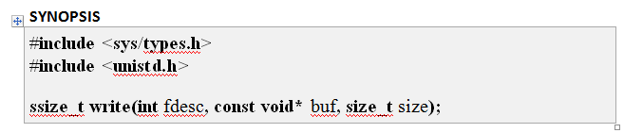
Write
The write function used to write
The write function puts data to a file in the form of fixed block size referred by a given file descriptor
#include <sys/types.h> #include <unistd.h> ssize_t read (int fdesc ,void* buf, size_t size);

Slide 26
If successful, write returns the number of bytes actually written.
If unsuccessful, write returns –1.
The first argument, fdesc is an integer that refers to an opened file.
The second argument, buf is the address of a buffer that contains data to be written.
The third argument, size specifies how many bytes of data are in the buf argument.
The return value is usually equal to the number of bytes of data successfully written to a file

Slide 27
Close
Disconnects a file from a process
Close function will deallocate system resources
It a process terminates without closing all the files it has opened ,the kernel will close those files for the process
#include <unistd.h> int close (int fdesc);

Slide 28
fcntl
Change the properties of a file that is already open
The function helps to query or set access control flags and the close-on-exec flag of any file descriptor
The first argument fdesc, is an integer file descriptor that refer to an opened file.
cmd argument specifies which operation to perform on a file referenced by the fdesc argument
#include <fcntl.h> Int fcntl (int fdesc ,int cmd);

Slide 29
Five different purposes
Duplicate an existing descriptor (F_DUPFD)
Get/Set file descriptor flags(F_GETFD or F_SETFD)
Get/Set file status flag(F_GETFL or F_SETFL)
Get/Set I/O ownership (F_GETOWN or F_SETOWN)
Get/Set record locks( F_GETLK F_SETLK or F_SETLKW)

Slide 30
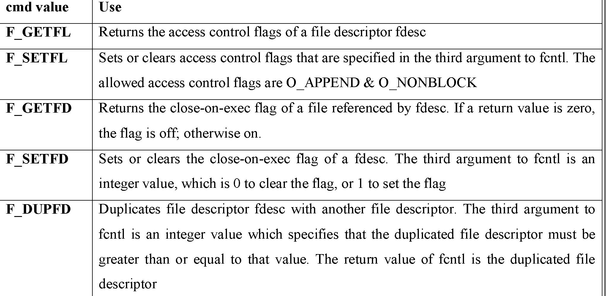

Slide 31
The fcntl function is useful in changing the access control flag of a file descriptor.
example: after a file is opened for blocking read-write access and the process needs to change the access to non-blocking and in write-append mode, it can call:
int cur_flags=fcntl(fdesc,F_GETFL);
int rc=fcntl(fdesc,F_SETFL,cur_flag | O_APPEND | O_NONBLOCK);

Slide 32
statements change the standard input of a process to a file called FOO:
int fdesc=open(“FOO”,O_RDONLY); //open FOO for read
close(0); //close standard input if(fcntl(fdesc,F_DUPFD,0)==-1)
perror(“fcntl”); //stdin from FOO now
char buf[256];
int rc=read(0,buf,256); //read data from FOO

Slide 33
The dup and dup2 functions in UNIX perform the same file duplication function as fcntl. They can be implemented using fcntl as:
#define dup(fdesc) fcntl(fdesc, F_DUPFD,0)
#define dup2(fdesc1,fd2) close(fd2),fcntl(fdesc,F_DUPFD,fd2)

Slide 34
lseek
the lseek system call is used to change the file offset to a different value
Prototype :
#include <sys/types.h> #include <unistd.h> Off_t sleek (int fdesc , off_t pos, int whence)

Slide 35
On success it returns new file offset, and –1 on error.
The first argument fdesc, is an integer file descriptor that refer to an opened file.
The second argument pos, specifies a byte offset to be added to a reference location in deriving the new file offset value.
The third argument whence, is the reference location.

Slide 36
Possible values of whence and corresponding reference locations are:
Whence location reference
SEEK_CUR current file pointer
address
SEEK_SET the beginning of a
file
SEEK_END the end of a file

Slide 37
They are defined in the <unistd.h> header.
If an lseek call will result in a new file offset two outcomes possible are:
If a file is opened for read-only, lseek will fail.
If a file is opened for write access, lseek will succeed. And it will extend the file size up to the new file offset address.
The data between the end-of-file and the new file offset address will be initialized with NULL characters.

Slide 38
link
The link function creates a new link for existing file
Prototype :
#include <unistd.h> int link (const char* cur_link ,const char* new_link)

Slide 39
If successful, the link function returns 0.
If unsuccessful, link returns –1.
The first argument cur_link, is the pathname of existing file.
The second argument new_link is a new pathname to be assigned to the same file.
If this call succeeds, the hard link count will be increased by 1.
The UNIX ln command is implemented using the link API.

Slide 40
unlink
The unlink function deletes a link of an existing file.
This function decreases the hard link count attributes of the named file, and removes the file name entry of the link from directory file.
A file is removed from the file system when its hard link count is zero and no process has any file descriptor referencing that file.

Slide 41
unlink
The prototype of unlink is
Cannot link a directory unless the calling function has the super user privilege
#include <unistd.h> int unlink (const char* cur_link );

Slide 42
If successful, the unlink function returns 0.
If unsuccessful, unlink returns –1.
The argument cur_link is a path name that references an existing file.

Slide 43
Rename
ANSI C defines the rename function which does the similar unlink operation.
The prototype of the rename function is:
#include<stdio.h>
int rename(const char * old_path_name,const char * new_path_name);

Slide 44
Stat fstat and lstat
The stat function returns a structure of information about the named file.
The fstat function obtains information about the file that is already open on the descriptor fields.
The lstat function is similar to stat, but when the named file is a symbolic link.
lstat returns information about the symbolic link, not the file referenced by the symbolic link.

Slide 45
Prototype
#include <sys/types.h> #include <unistd.h> int stat (const char* path_name,struct stat* statv) int fstat (const int fdesc,struct stat* statv) int lstat (const char* path_name , struct stat* statv);

Slide 46
The second argument is a pointer to a structure that we must supply.
The function fills in the structure pointed to by buf.

Slide 47
Difference between stat and fstat
The only is the first argument of a stat is a file pathname,
the first argument of fstat is file descriptor.
The second argument to stat and fstat is the address of a struct stat-typed variable which is defined in the <sys/stat.h> header.

Slide 48
The definition of the structure can differ among implementations, but it could look like
struct stat {
mode_t st_mode; /* file type & mode (permissions) */
ino_t st_ino; /* i-node number (serial number) */
dev_t st_dev; /* device number (file system) */
dev_t st_rdev; /* device number for special files */
nlink_t st_nlink; /* number of links */
uid_t st_uid; /* user ID of owner */
gid_t st_gid; /* group ID of owner */
off_t st_size; /* size in bytes, for regular files */
time_t st_atime; /* time of last access */
time_t st_mtime; /* time of last modification */
time_t st_ctime; /* time of last file status change */
blksize_t st_blksize; /* best I/O block size */
blkcnt_t st_blocks; /* number of disk blocks allocated */
};

Slide 49
The return value of both functions is
0 - if they succeed
-1 if they fail
errno contains an error status code

Slide 50
Access
when we open a file, The access function checks the existence access permission of user to a named file
the kernel performs its access tests based on the effective user and group IDs.
some times when a process wants to test accessibility based on the real user and group IDs.
This is useful when a process is running as someone else,

Slide 51
Prototype
#include <unistd.h>
int access (const char* path_name, int flag);

Slide 52
The flag contains one or more bit flags
Bit flags USE
F_OK checks whether the file exists
R_OK checks whether calling
process has read permission
W_OK checks whether calling
process has write permission
X_OK checks whether calling
process has execute permission

Slide 53
int rc=access(“/usr/pesce/usp.txt”,R_OK | W_OK);
example to check whether a file exists:
if(access(“/usr/pesce/usp.txt”, F_OK)==-1) printf(“file does not exists”);
else
printf(“file exists”);

Slide 54
Chmod fcmod
The chmod and fcmod functions change file access permissions for owner, group and others.
#include <sys/types.h> #include <sys/stat.h> #include <unistd.h> int chmod (const char* path_name, mode_t flag); int fchmod (int fdsec, mode_t flag);

Slide 55
The pathname argument of chmod is the path name of a file whereas the fdesc argument of fchmod is the file descriptor of a file.
The chmod function operates on the specified file, whereas the fchmod function operates on a file that has already been opened.
To change the permission bits of a file, the effective user ID of the process must be equal to the owner ID of the file, or the process must have super-user permissions.

Slide 56

Every process has six or more IDs associated with it.
real user ID real group ID | who we really are
effective user ID effective group ID supplementary group IDs | used for file access permission checks
saved set-user-ID saved set-group-ID | saved by exec functions

Slide 57
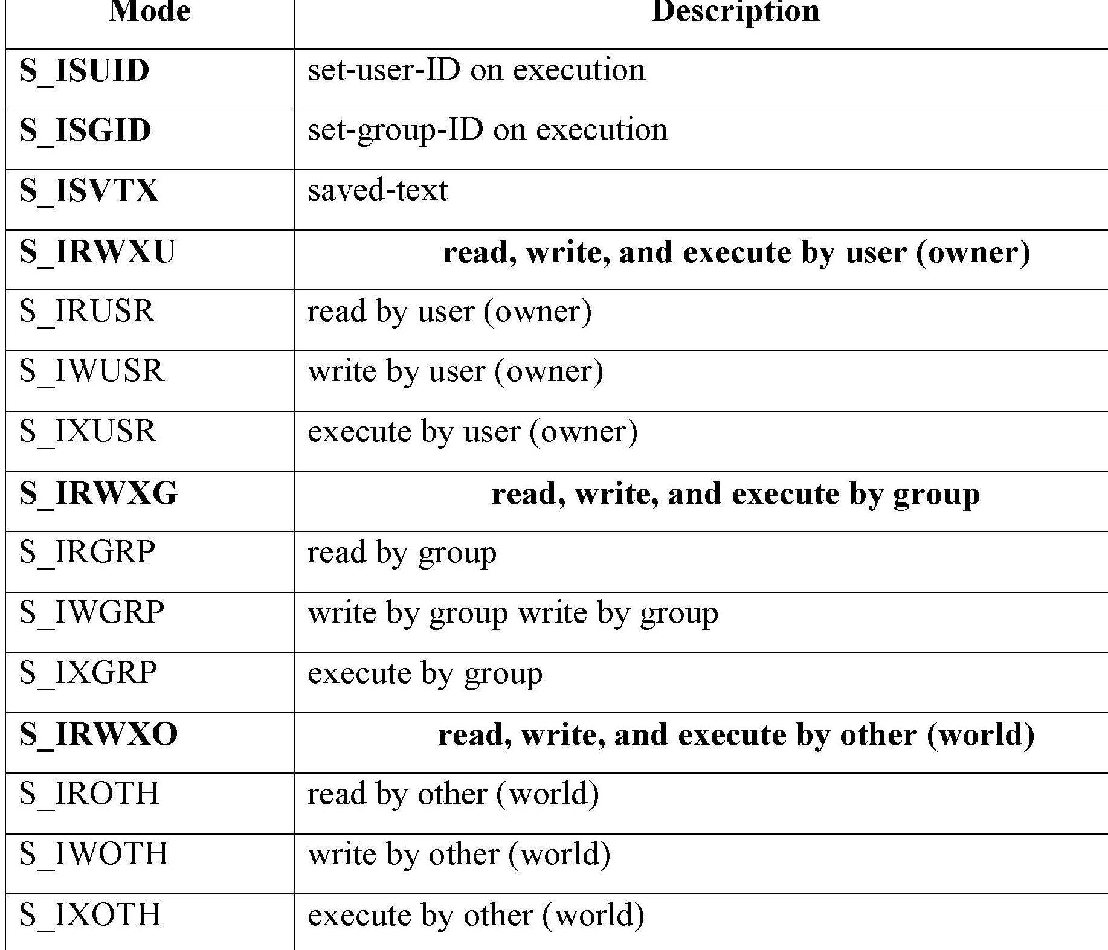

Slide 58
Chown fchown lchown
The chown and fchown function change the user ID and group ID of files
lchown changes the ownership of symbolic link file
#include <unistd.h> #include <sys/types.h> int chown (const char* path_name, uid_t uid, gid_t gid); int fchown (int fdesc, uid_t uid, gid_t gid); int lchown (const char* path_name, uid_t uid, gid_t gid);

Slide 59
The path_name argument is the path name of a file.
The uid argument specifies the new user ID to be assigned to the file.
The gid argument specifies the new group ID to be assigned to the file.

Slide 60
utime
The access time and the modification time of a file can be changed with the help of utime function.
#include <unistd.h> #include <sys/types.h> #include <utime.h> int utime (const char* path_name, struct utimbuf* times);
On success it returns 0, on failure it returns –1.

Slide 61
The path_name argument specifies the path name of a file.
The times argument specifies the new access time and modification time for the file.

Slide 62
The struct utimbuf is defined in the <utime.h> header
Struct utimbuf
{
time_t actime;
time_t modtime;
};

Slide 63
The time_t datatype is an unsigned long and its data is number of seconds elapsed since birthday of unix:12AM January 1 1970.
If the times (variable) is specified as NULL, the function will set the named file access and modification time to the current time.
If the times (variable) is an address of the variable of the type struct utimbuf, the function will set the file access time and modification time to the value specified by the variable.

Slide 64
Directory File APIs
Why do need directory files? Uses?
To help users in organizing their files into some structure based on the specific use of files
They are also used by the operating system to convert file path names to their inode numbers

Slide 65
A Directory file is a record-oriented file, where each record stores a file name and the inode number of a file that resides in that directory.
Directories are created with the mkdir API and deleted with the rmdir API.

Slide 66
To create a directory use mkdir API
int mkdir (const char* path_name , mode_t
mode);
The mode argument specifies the access permission for the owner,group, and others to be assigned to the file.

Slide 67
A newly created directory has its user ID set to the effective user ID of the process that creates it.
Directory group ID will be set to either the effective group ID of the calling process or the group ID of the parent directory that hosts the new directory.

Slide 68
FUNCTIONS
Opendir:
DIR*opendir (const char* path_name);
This opens the file for read-only
Readdir:
Dirent* readdir(DIR* dir_fdesc);
The dir_fdesc value is the DIR* return
value from an opendir call.

Slide 69
Closedir :
int closedir (DIR* dir_fdesc);
It terminates the connection between the
dir_fdesc handler and a directory file.
Rewinddir :
void rewinddir (DIR* dir_fdesc);
Used to reset the file pointer associated
with a dir_fdesc.

Slide 70
To remove directory use Rmdir API:
int rmdir (const char* path_name);
Used to remove the directory files.
Users may also use the unlink API to remove directories provided they have super-user privileges.
These API’s require that the directories to
be removed be empty, in that they contain
no files other than “.” and “..” links.

Slide 71
Device file APIs
Device files are used to interface physical device with application programs.
A process with super-user privileges to create a device file must call the mknod API.
The user ID and group ID attributes of a device file are assigned in the same manner as for regular files.

Slide 72
When a process reads or writes to a device file, the kernel uses the major and minor device numbers of a file to select a device driver function to carry out the actual data transfer.
Device file support is implementation dependent. UNIX System defines the mknod API to create device files.

Slide 73
To create:
int mknod(const char* path_name, mode_t
mode,int device_id);
The mode argument specifies the access permission of the file
The device_id contains the major and minor device numbers. The lowest byte of a device_id is set to minor device number and the next byte is set to the major device number.
A device file may be removed via the unlink API.

Slide 74
MAJOR AND MINOR NUMBERS
When a process reads from or writes to a device file, the file’s major device number is used to locate and invoke a device driver function that does the actual data transmission.
The minor device number is an argument being passed to a device driver function when it is invoked. The minor device number specifies the parameters to be used for a particular device type.

Slide 75
Difference between mkdir and mknod
Directory created by mknod API does not contain the “.” and “..” links. These links are accessible only after the user explicitly creates them.
Directory created by mkdir has the “.” and “..” links created in one atomic operation, and it is ready to be used.

Slide 76
FIFO File APIs
These are special device files used for interprocess communication.
Data written to a FIFO file are stored in a fixed-size buffer and retrieved in a
first-in-first-out order.
To create:
int mkfifo( const char* path_name, mode_t
mode);

Slide 77
How is synchronization provided?
When a process opens a FIFO file for read-only, the kernel will block the process until there is another process that opens the same file for write.
If a process opens a FIFO for write, it will be blocked until another process opens the FIFO for read.
This provides a method for process
synchronization

Slide 78
If a process writes to a FIFO that is full, the process will be blocked until another process has read data from the FIFO to make room for new data in the FIFO.
If a process attempts to read data from a FIFO that is empty, the process will be blocked until another process writes data to the FIFO.
If a process does not desire to be blocked by a FIFO file, it can specify the O_NONBLOCK flag in the open call to the FIFO file.

Slide 79
UNIX System V defines the O_NDELAY flag which is similar to the O_NONBLOCK flag. In case of O_NDELAY flag the read and write functions will return a zero value when they are supposed to block a process.
If a process writes to a FIFO file that has no other process attached to it for read, the kernel will send a SIGPIPE signal to the process to notify it of the illegal operation.

Slide 80
If Two processes are to communicate via a FIFO file, it is important that the writer process closes its file descriptor when it is done, so that the reader process can see the end-of-file condition.
Pipe API
Another method to create FIFO files for
interprocess communications
int pipe (int fds[2]);

Slide 81
Symbolic Link File APIs
A symbolic link is an indirect pointer to a file.
These were developed to overcome several weakness of hard links.
A hard link is only an additional name for an existing file on Linux or other Unix-like operating systems.
Hard links are created with the ln command.
[root@localhost ~] # ln file1 hlink1
create a hard link named hlink1 to a file named file1, both in the current directory

Slide 82
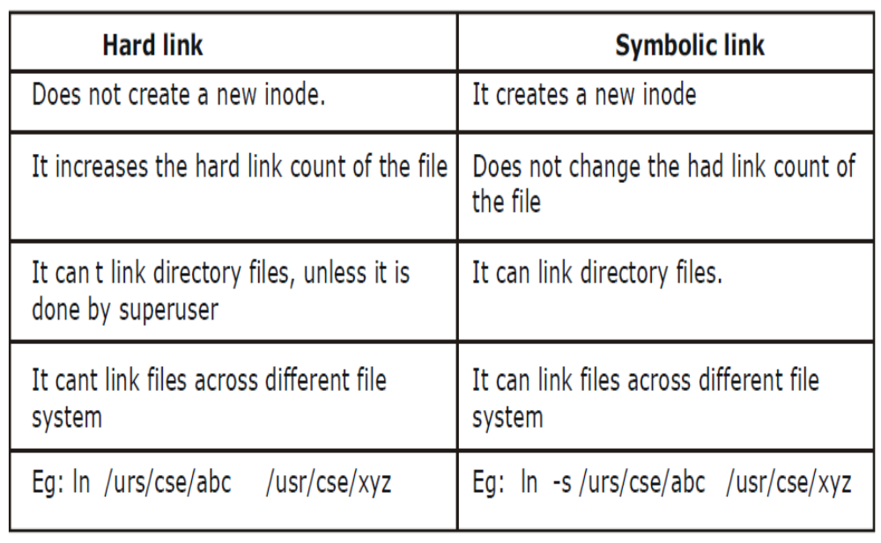
Symbolic Link File APIs

Slide 83
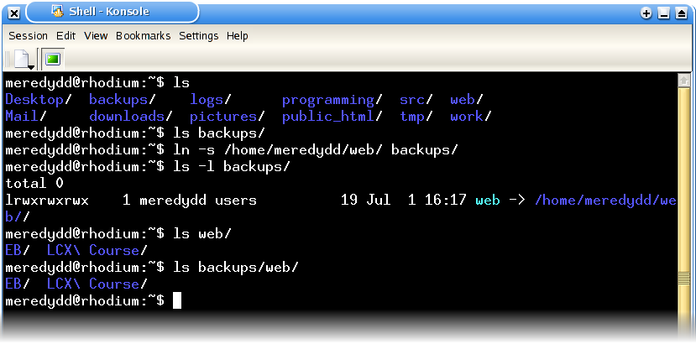

Slide 84
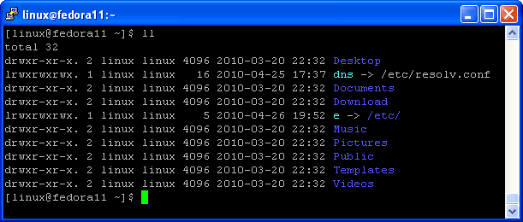

Slide 85
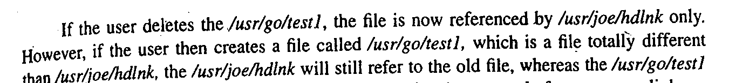
Symbolic Link File APIs
Symbolic links can link from across file systems
Symbolic links can link directory files
Symbolic links always reference the latest version of the file to which they link
Consider: /usr/go/test1 and /usr/joe/hdlnk

Slide 87
Symbolic Link File APIs
If the user creates the new /usr/joe/symlnk will automatically refer to this file and the links is reestablished again.
To create symbolic link file:
int symlink (const char* actualpath, const
char* sympath);
int readlink (const char* sympath, char* buf,
int size);

Slide 88
To QUERY the path name to which a symbolic link refers, users must use the readlink API. The arguments are:
Sympath: is the path name of the symbolic link
buf is a character array buffer that holds the return path name referenced by the link
size specifies the maximum capacity of the buf argument

Slide 89
A new directory entry, sympath, is created that points to actualpath. It is not required that actualpath exist when the symbolic link is created.
Also, actualpath and sympath need not reside in the same file system.

Slide 90
the open function follows a symbolic link, we need a way to open the link itself and read the name in the link. The readlink function does this.
readlink function combines the actions of open, read, and close. If the function is successful, it returns the number of bytes placed into buf.

Slide 91
FILE AND RECORD LOCKING
UNIX systems allow multiple processes to read and write the same file concurrently.
This provides a means for data sharing among processes, but it also make difficulty for any process in determining when the other process can overridden data in a file.
This is especially for database.

Slide 92
example illustrates the act as mediator update problem
Process A reads a customer record from a file containing account information, including the customer's account balance and phone number.
Process B now reads the same record from the same file so it has its own copy.
Process A changes the account balance in its copy of the customer record and writes the record back to the file.

Slide 93
Process B, which still has the original old value for the account balance in its copy of the customer record, updates the account balance and writes the customer record back to the file.
Process B has now written its old account-balance value to the file, causing the changes made by process A to be lost

Slide 94
UNIX and POSIX standard support file locking mechanism.
File locking is applicable for regular files.
The earliest versions of UNIX had no way to lock files except to create lock files.

Slide 95
File locking allows a process to require a lock on a file so that other processes cannot modify the file until it is unlocked by the process.
File locking is a mechanism that restricts access to a computer file by allowing only one user or process access at any specific time.

Slide 96
File locking is the act of guarantee that when you access a file, usually via a software application, no one can change the file until you are done examining it. If you want to modify the file, then file locking ensures that no one else can examine or modify the file until you are done modifying it.

Slide 97
a process can require a write lock or read lock on either a portion of a file or on the entire file.
The differences between the read lock and the write lock is that:
1. when write lock is set, it avoid the other process from setting any over-lapping read or write lock on the locked file.
Similarly when a read lock is set, it avoid other processes from setting any overlapping write locks on the locked region of a file.

Slide 98
The intension of the write lock is to avoid other processes from both reading and writing the locked region while the process that sets the lock is modifying the region, so write lock is termed as “Exclusive lock”.
The use of read lock is to avoid other processes from writing to the locked region while the process that sets the lock is reading data from the region.
Other processes are allowed to lock and read data from the locked regions. Hence a read lock is also called as “shared lock “.

Slide 99
File lock may be mandatory (compulsory) if they are implementing by an operating system kernel.
If a mandatory exclusive lock is set on a file, no process can use the read or write system calls to access the data on the locked region.
These mechanisms can be used to coordinate reading and writing of shared files by multiple processes.
If a process locks up a file, other processes that attempt to write to the locked regions are blocked until the former process releases its lock.

Slide 100
Problem with mandatory lock
if a escapee process sets a mandatory exclusive lock on a file and never unlocks it, then, no other process can access the locked region of the file until the runway process is killed or the system has to be rebooted.

Slide 101
If locks are not mandatory, then it has to be advisory lock.
A kernel at the system call level does not make compulsory advisory locks.
a lock may be set on a file, no other processes can still use the read and write functions to access the file.

Slide 102
To make use of advisory locks, process that manipulate the same file must co-operate such that they follow the given below procedure for every read or write operation to the file.
  Try to set a lock at the region to be accesses. If this fails, a process can either wait for the lock request to become successful.
  After a lock is acquired successfully, read or write the locked region.
  Release the lock.

Slide 103
Lock Promotion
If a process sets a read lock on a file, for example from address 0 to 256, then sets a write lock on the file from address 0 to 512, the process will own only one write lock on the file from 0 to 512, the previous read lock from 0 to 256 is now covered by the write lock and the process does not own two locks on the region from 0 to 256.

Slide 104
Lock Splitting
a process now unblocks the file from 128 to 480, it will own two write locks on the file: one from 0 to 127 and the other from 481 to 512.
UNIX systems provide fcntl function to support file locking. By using fcntl it is possible to impose read or write locks on either a region or an entire file.

Slide 105
UNIX systems provide fcntl function to support file locking. By using fcntl it is possible to impose read or write locks on either a region or an entire file.
The prototype of fcntl is:
#include<fcntl.h>
int fcntl(int fdesc, int cmd_flag, ....);

Slide 106

The first argument specifies the file descriptor.
The second argument cmd_flag specifies what operation has to be performed.
If fcntl is used for file locking then it can values as

Slide 107
For file locking purpose, the third argument to fctnl is an address of a struct flock type variable.
This variable specifies a region of a file where lock is to be set, unset or queried.
struct flock
{
short l_type; /* what lock to be set or to unlock file */
short l_whence; /* Reference address for the next field */
off_t l_start ; /*offset from the l_whence reference addr*/
off_t l_len ; /*how many bytes in the locked region */
pid_t l_pid ; /*pid of a process which has locked the file */
};

Slide 108

The l_type field specifies the lock type to be set or unset.
which are defined in the <fcntl.h> header
The possible values, and their uses are:

Slide 109

The l_whence, l_start & l_len define a region of a file to be locked or unlocked.
The possible values of l_whence and their uses are

Slide 110
l_len specifies the size of a blocked region beginning from the start address as defined by l_whence and l_start.

